Slide 1

The Flying Sidekick Travelling Salesman Problem with Integrated Pickup and Delivery (FSTSP-PD)
Nawin Yanpirat, Daniel F. Silva, and Alice E. Smith
Department of Industrial & Systems Engineering
Auburn University

Slide 2
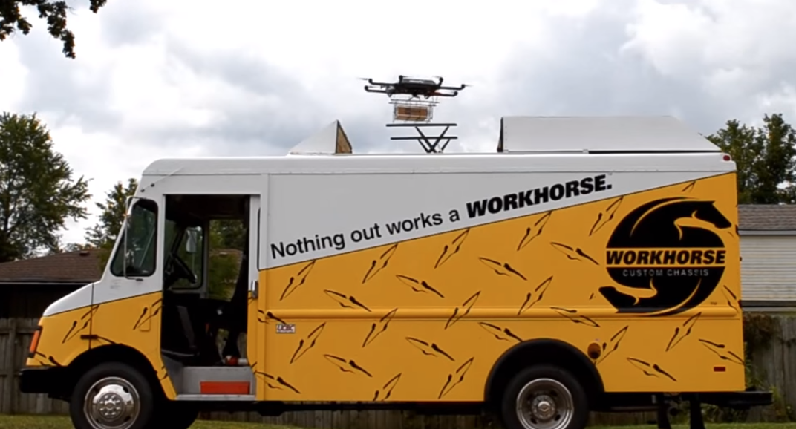
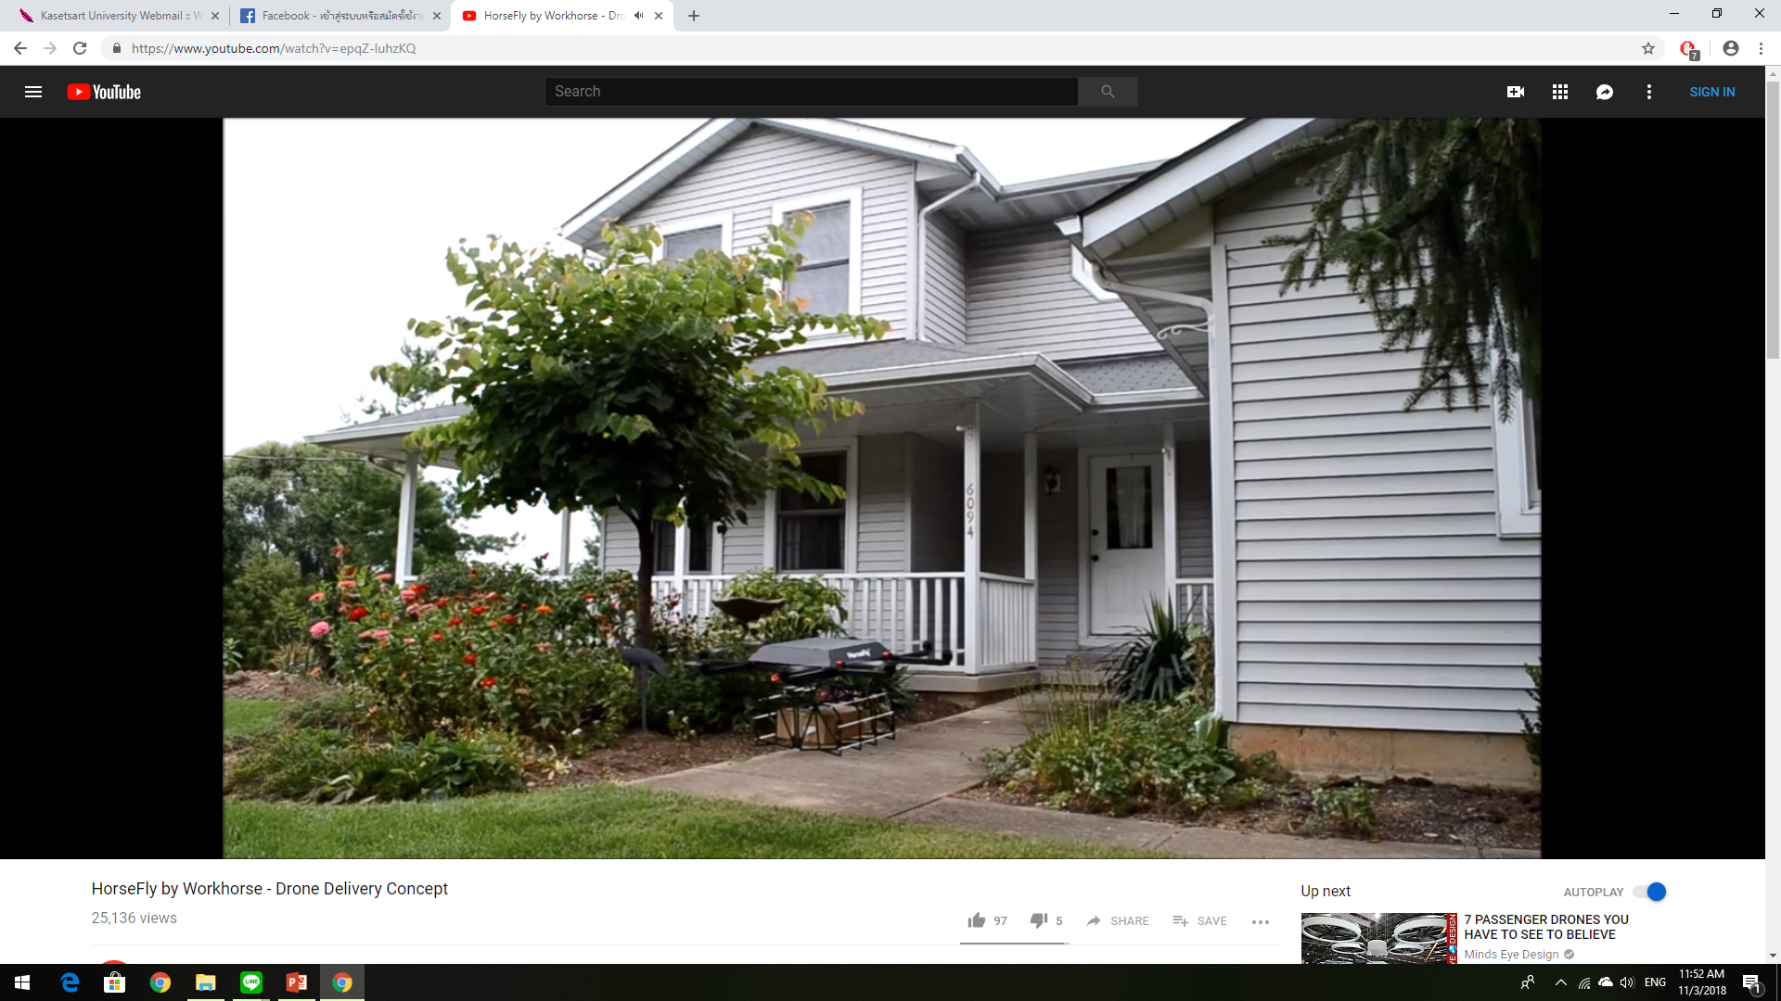
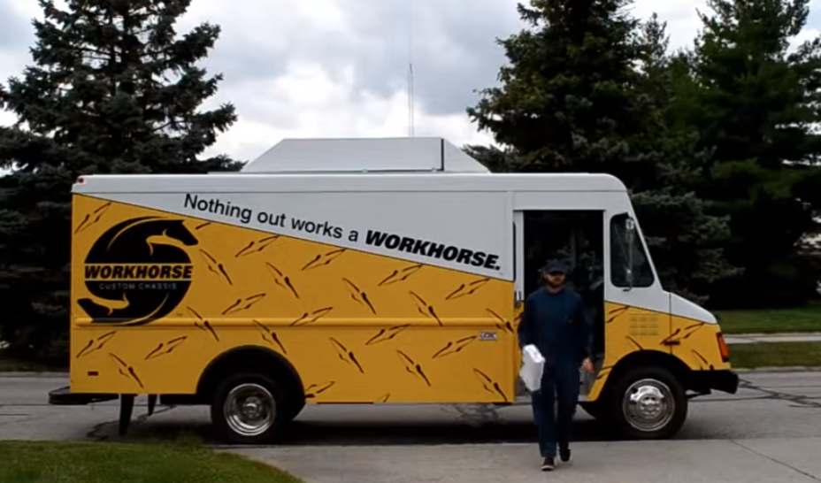
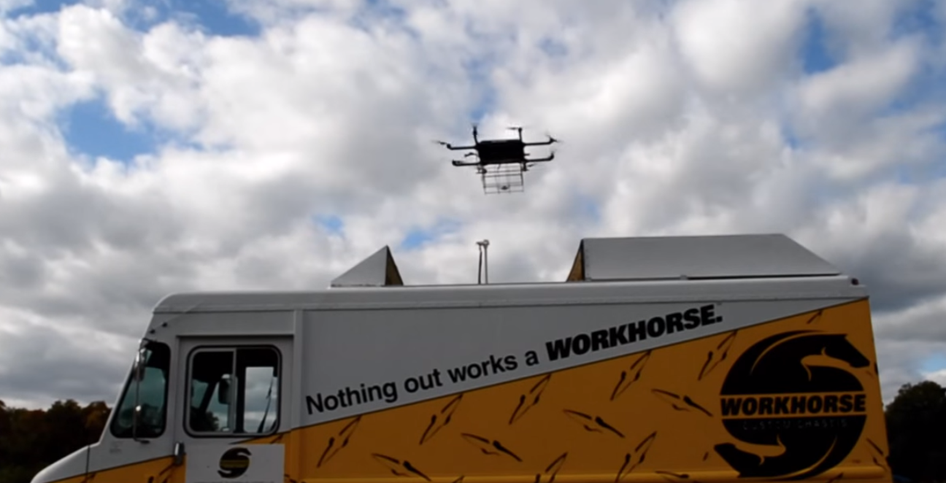
Outline
Introduction
Assumptions
Truck and Drone
Routes: Example
Experiment
Results
Conclusions
Future Research
https://www.youtube.com/watch?v=epqZ-IuhzKQ

Slide 3
Introduction
Benefits of pickup function
Increase utilization of drones
Reduce inconvenience of returning goods
Potentially serve more customers in a given area
According to Steve Dennis (2017), e-commerce has a return rate between 25 - 40 percent
Notes:
Prevent flying back to the truck with empty storage
Forbes News
https://www.forbes.com/sites/stevendennis/2017/08/09/many-unhappy-returns-e-commerces-achilles-heel/#13de443c4bf2

Slide 4
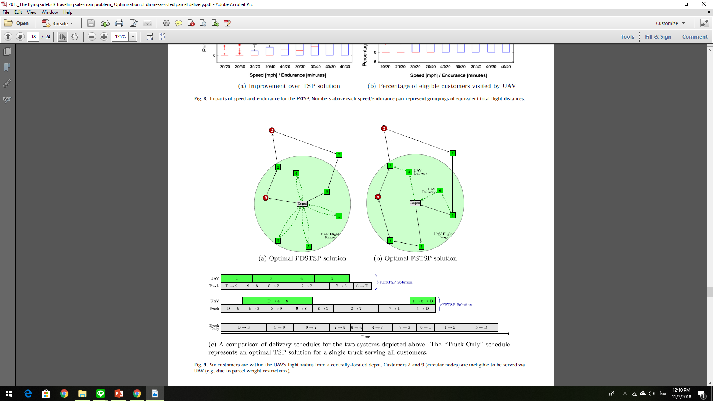
Introduction (Con’t)
This MILP formulation is based on The Flying Drone Sidekick Traveling Salesman Problem from Murray and Chu (2015)
Adds constraints to allow a drone to collect parcels from the same or another customer after delivering parcels

Slide 5
Drone function
The drone operation for each trip can be either
  Delivery only
  Pickup only
  Delivery and Pickup

Slide 6
Assumptions
One truck and one drone.
Both truck and drone have constant speeds.
The drone can carry only one parcel at a time.
The drone cannot service all customers.
All customers must be served by either the drone or the truck.

Slide 7
Assumptions (Con’t)
The drone can depart from the truck at any customer location or the depot.
The drone can rendezvous with the truck at any customer location or at the depot.
If the drone arrives at the rendezvous point before the truck, it must hover until the truck comes.

Slide 8
Assumptions (Con’t)
The drone uses the same amount of energy traveling or hovering.
The drone must leave customer locations immediately after picking up or delivering a parcel.
The drone has to leave before the truck leaves at any customer location but not at the depot.

Slide 9
Truck and Drone Routes

Slide 10
Truck and Drone Routes (Cont.)

Slide 11
Experiment
Performance measurement: Total service time of FSTSP-PD vs. TSP or FSTSP.
Parameters: the number of pickup customers, drone endurance, and speed of the drone.
The proposed model is NP-hard; we limited the experiments to instances of 10 customers.
Solved by CPLEX Python API.

Slide 12
Experiment (Con’t)
 | Factors | Levels
1 | Number of pickup customers | 0, 1, 2, 3, 4 customers
2 | Drone endurance | 20 and 40 minutes
3 | Drone speed | 35 and 45 miles per hour

Slide 13
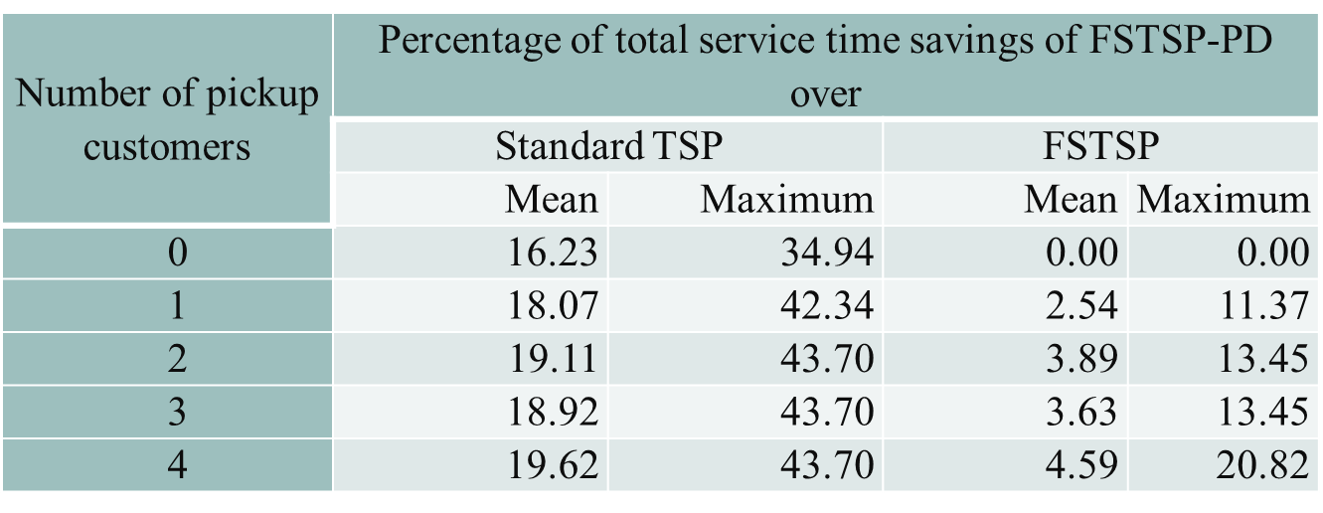
Experimental Results: Number of pickup customers
Where drone endurance and drone speed are 20 and 35, respectively

Slide 14
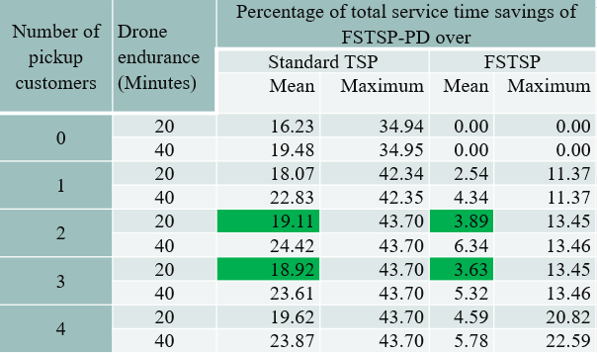
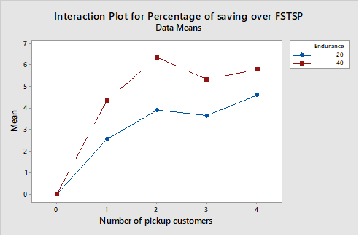
Experimental Results: Drone Endurance
Where drone speed is 35 mph
Notes:
Point out the green color

Slide 15
Experimental Results
Number of Pickup Customers | Total Service Time (minutes)
0 | 60.7433
1 | 54.3950
2 | 53.4183
3 | 60.0737
4 | 60.0737
Where drone endurance: 40 and drone speed: 45

Slide 16
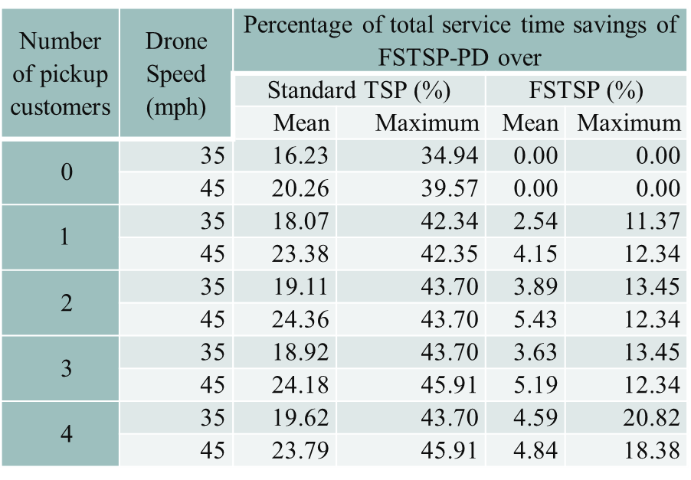
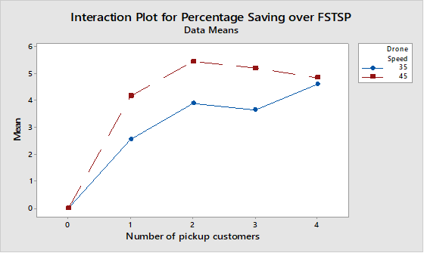
Experimental Results: Drone Speed
Where drone endurance is 20 minutes

Slide 17
Conclusions
Total service time can be reduced up to 7 percent compared to the standard FSTSP.
Only drone endurance and number of pickup customers impact reducing total service time.
The most important factor is the number of pickup customers.
Increasing the number of pickup customers might lead to poor total service time.
Notes:
By adding pickup function into FSTSP problem, the total service time can be saved up to 7 percent comparing with standard FSTSP problem. Moreover, the favorable number of pickup customers that yields the lowest total service time is approximately between 20 percent out of the total customers.

Slide 18
Future Research
Increase size of the data set.
Develop a heuristic or meta-heuristic for better running time.
Consider multiple trucks and drones.
Multiple objectives such as cost functions.
Notes:
First, recall that the greater the number of customers, the more complex the computation is, and the greater the limitations of computers to solve the problems optimally. Therefore, we should develop other techniques, such as heuristic or meta-heuristic methods, that address this matter. Furthermore, the assumption of unlimited truck capacity, which is unrealistic, should be relaxed to include the possibility of using multiple trucks and drones. In addition to the total service time of system, the total cost of the system should not be overlooked. Therefore, bi-criteria FSTSP-PD is also a challenge for future consideration

